Slide 1
Status of MEG
Physics Analysis
Fabrizio Cei
INFN and University of Pisa - Italy
BVR PSI, 17 February 2010

Slide 2
Outline
Results of physics analysis of 2008 data.
Present status of physics analysis:
- summary of physics analysis for individual
sub-detectors;
- observation of radiative decay events
in MEG 2009 data;
Perspectives for 2009 data analysis.

Slide 3
2008 Data Analysis

Slide 4
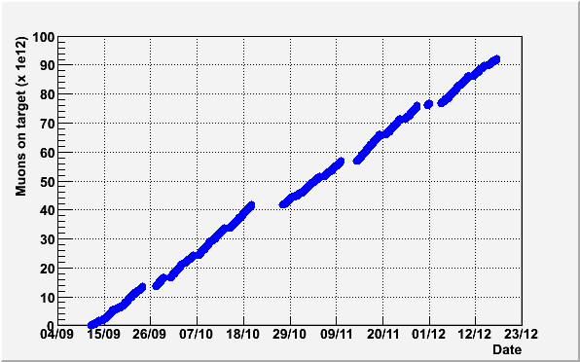
2008 run: 10¹⁴ μ⁺ stopped in target
We also took RMD data once/week at reduced beam intensity
RD
Programmed beam shutdowns
RD
RD
RD
RD
Air test in COBRA
RD
Cooling system repair

Slide 5
Pre-selection/blinding windows
Plane (E_{γ}, Δt) used
for pre-selection +
reconstructed track
with associated TC hit
Blinded files:
0.2 % events
Open files: 16 % events
Pre-selection process repeated several times with improving calibrations and
algorithms. Final blinding box: ± 1 ns around zero (timing offset subtracted).

Slide 6
Normalization 1)
where:
10⁷ pre-scaling factor
f_{S}/f_{M} is obtained by generating and reconstructing large samples of
MC events (for signal and Michel) in various configurations to take
into account the DCH instabilities
TRG = 22: Michel events trigger (only DCH track required)
TRG = 0: MEG events trigger

Slide 7
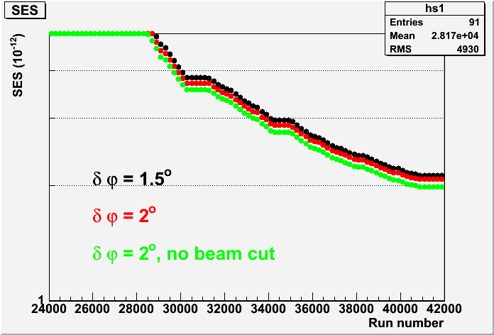
Normalization 2)
Final Value
k = 4.7∙10¹¹ ± 10%
Independent computation
k = 4.9∙10¹¹ ± 10%
2
k = 1/”SES” (not exactly
a “SES”: not zero bck)
Advantage of this technique: it uses the MEASURED number of Michel positrons instead of the CALCULATED number of stopping muons/second ⇒ it is independent of time varying DCH acceptance and efficiency. Result confirmed by computations based on time-averaged acceptance and efficiency.

Slide 8
Generalities on analysis
Three independent blind-likelihood analyses.
RD and accidental event rates in the signal region fitted or
estimated a priori by means of side-bands information.
Feldman-Cousins method for C.L. determination.
Kinematical variables used:
- Positron and Gamma Energies;
- Relative timing and relative angle;
Likelihood function:
Signal PDF
RD PDF
N_{obs} = number of observed events
Accidental BCK PDF

Slide 9
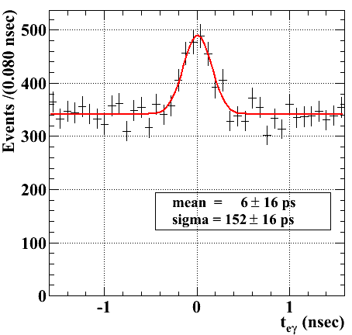
Analysis: PDF determination 1)
Signal: Gamma Energy from π⁰ (DRS) or MC taking into account resolution (TRG);
Positron Energy: 3 gaussian shapes; sigma’s extracted from Michel positron fit;
Positron-Photon relative angle: toy MC based on experimental angular
resolutions of positrons and photons;
Positron-Photon relative timing: gaussian
shape with sigma = 147 (or 135) ps from
radiative decay data fit with Gamma
Energy outside of Blinding Box.
Radiative Decay:
Gamma Energy + Positron Energy + Relative
Angle e⁺-γ: 3-D distribution based on theoretical
shape folded with detector response (correlations);
Relative Timing e⁺-γ: gaussian shape with
sigma = 147 (or 135) ps as for signal.

Slide 10
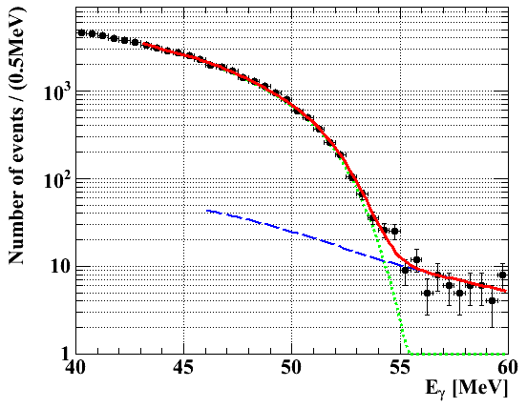
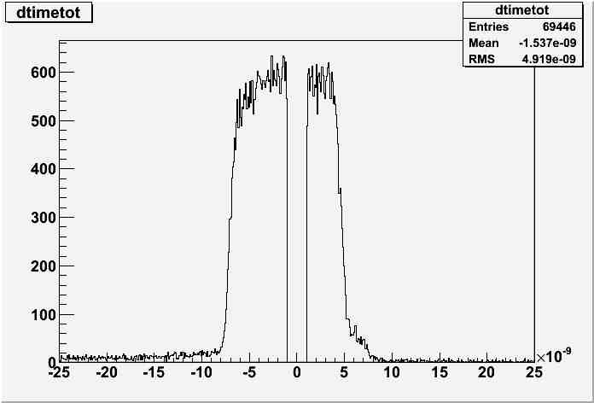
Analysis: PDF determination 2)
Accidental bck: fit of Gamma Energy, Positron Energy and Relative Angle for
events falling in ΔT “side bands” ⇒ |ΔTeγ| > 1 ns
Gamma Energy
Accidental radiative decay + Positron Annihilation in flight + resolution + pileup
Important point: the PDF of the most dangerous background can be measured !

Slide 11
Sensitivity evaluation
Expected sensitivity evaluated with two methods:
Toy MC assuming zero signal (two independent calculations):
- generated 1000 independent samples of events using bck and RD pdf’s;
- upper bound on number of signal events evaluated for each sample;
- average upper bound @90% C.L: 6 events ⇒
- average upper bound on B.R.(μ → eγ) = 1.3 x 10⁻¹¹.
Fit to events in the sidebands:
- applied same fitting procedure used for data in the signal region;
- upper bound: B.R.(μ → eγ) ≤ (0.9 ÷ 2.1) x 10⁻¹¹.
Comparison: present upper bound from MEGA experiment: 1.2 x 10⁻¹¹

Slide 12
Likelihood analysis
Results in close agreement from the three analyses.
Fit in the signal region
Checks:
Number of RD events in
agreement with predictions
and extrapolations from
sidebands;
Test of C.L. extraction
with bayesian technique;
Fits using TRG instead of
DRS information and
different ΔT computation
algorithms;
Fit to ΔT only (sensitive
to signal + RD).

Slide 13
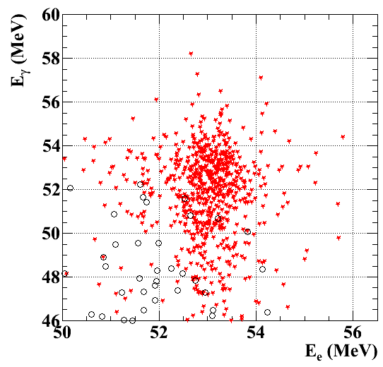
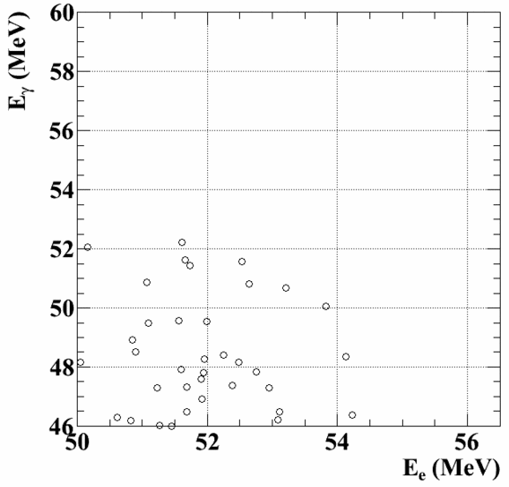
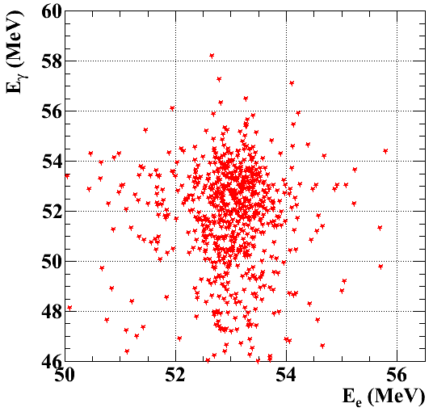
E_{γ} vs E_{e+}
10³ MC events
Cut at 90% efficiency on other variables (relative angle and relative timing)

Slide 14
B.R.(μ → eγ) 90 % C.L. limit
From the 90 % C.L. upper bound on number of signal events:
N_{Sig} ≤ 14.7
we obtained the corresponding 90 % C.L. upper limit:
BR(μ⁺ → e⁺γ) ≤ 2.8 x 10⁻¹¹
≈ 2 times worse than the expected sensitivity.
The probability of getting this result by a statistical
fluctuation of the observed distributions is (3 ÷ 5) %
(Bad Luck !)
Results available at arXiv:0908.2594.
Paper to be submitted soon.

Slide 15
Present status of physics analysis

Slide 16
DCH
Several quantities to be calibrated:
Common timing offset (t₀);
Relative timing between end of wires (⇒ r);
Anode and pads charges (⇒ z).
Standard calibrations completed and implemented.
Alternative calibrations/algorithms under way to:
Check the origin of not yet adequate
performances by means of independent codes;
Try to improve such performances.
Alignment check by cosmic rays measurements.

Slide 17
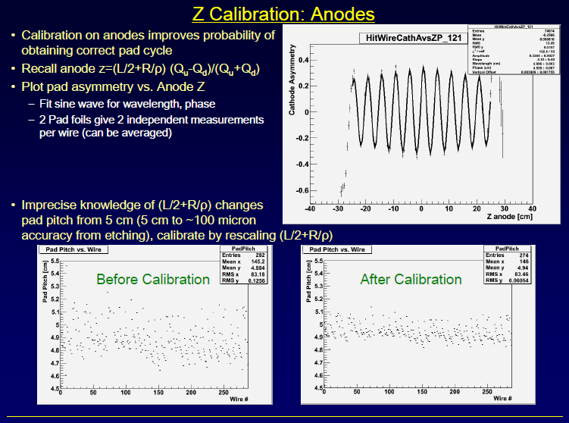
DCH standard calibrations: z anodes
Size of pad pitch

Slide 18
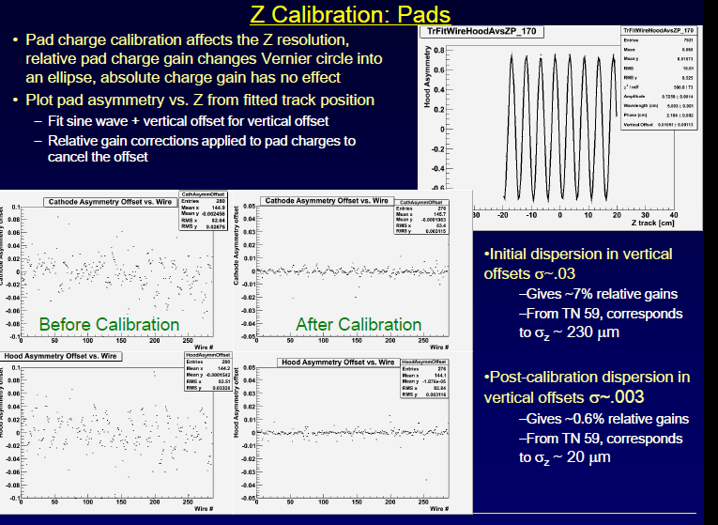
DCH standard calibrations: z pads
Vertical offset
Cathode
Hood

Slide 19
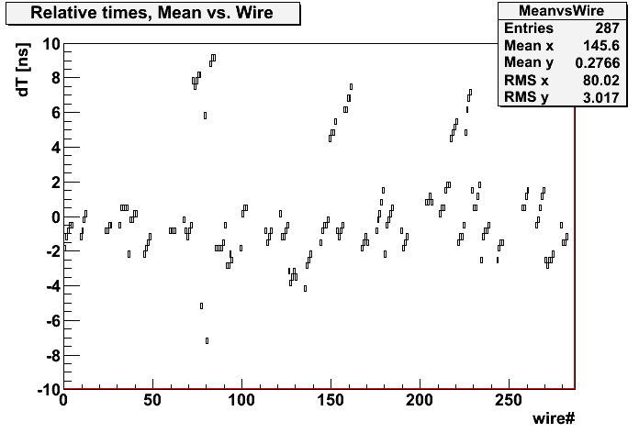
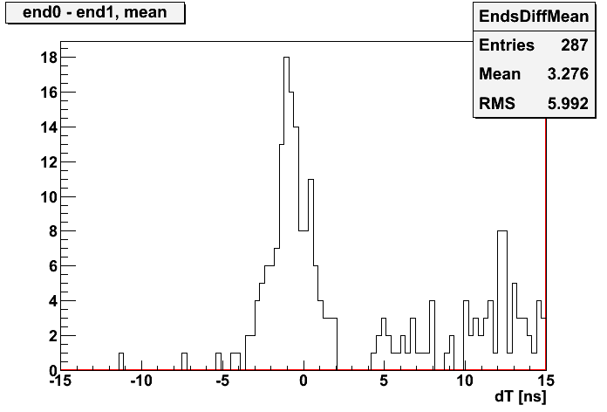
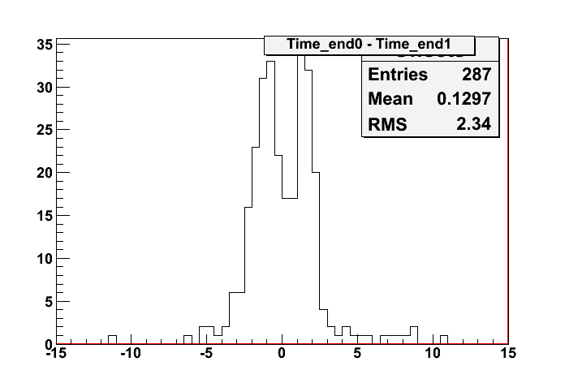
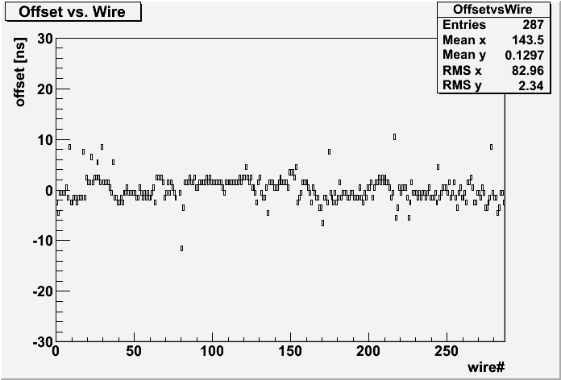
Relative timing between ends of wires
not calibrated
(Time_end0 – Time_end1) vs Wire
Low Track Statistics
calibrated
Low Gain
Channels with sync Offsets
(T_end0 –T_end1) vs wire
Ch’s with sync problems
The relative offsets of the calibrated data show a double peak. Since, this double peak structure comes about after calibration, it’s good indication that there is a pattern in the leading edge fits, or, first peak remained while deviant data points populated second peak. Under investigation.
Shows relative offsets before and after calibration. The RMS of the not calibrated data seems to be dominated by deviant wires.

Slide 20
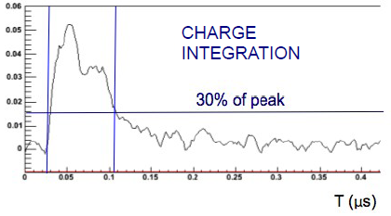
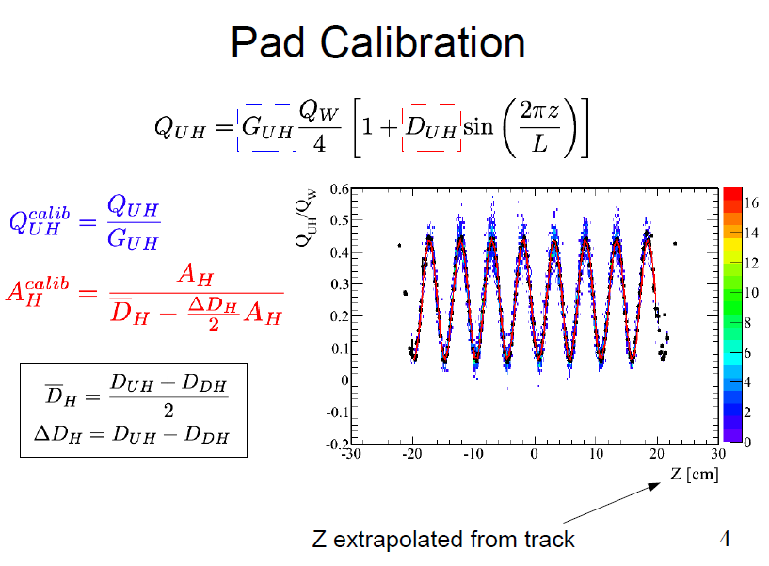
Alternative algorithms/calibrations
Integration based on trapezoidal method
T (μs)
Fit each separated
charge independently
as a function of z
Z extrapolated from track

Slide 21
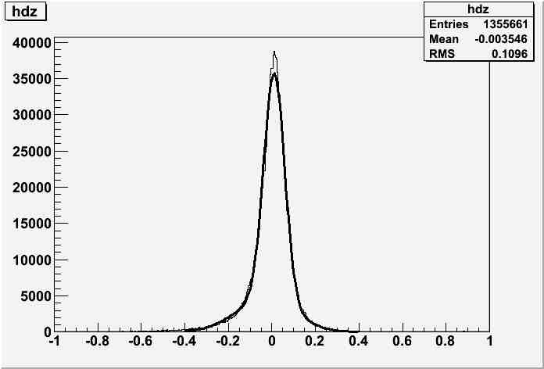
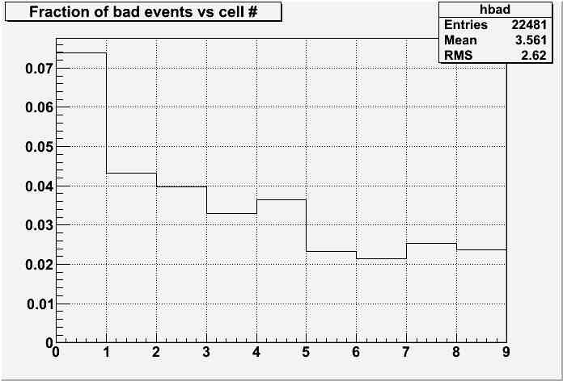
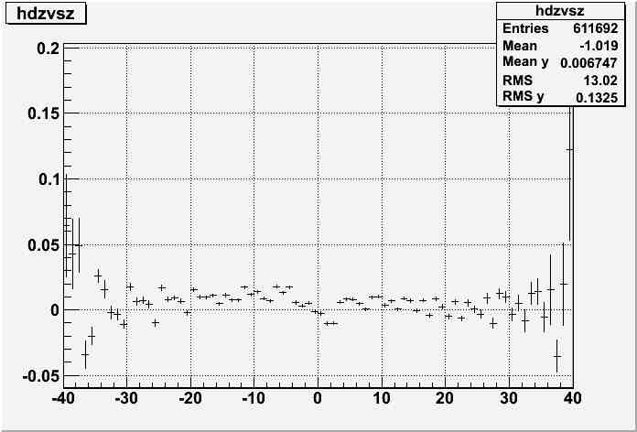
Single hit Z resolution
Double
gaussian fit
|ΔZ| > 0.3 cm
cm
|ΔZ| > 0.3 cm
σ_{core} = 480 μm,
core fraction = 0.722,
mean -35 μm (asymmetric tail)

Slide 22
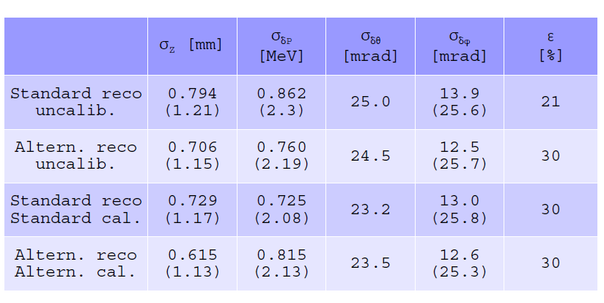
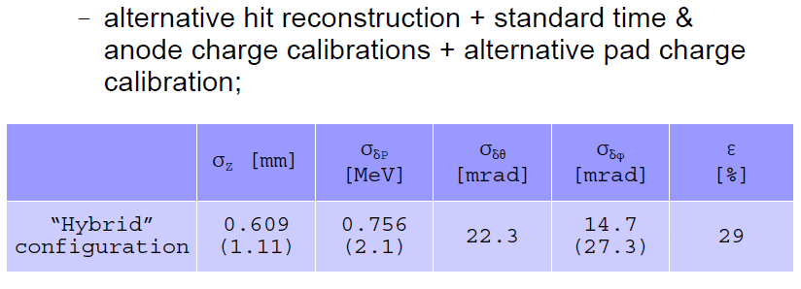
Comparison of performances
All these numbers
were obtained
by using the
double-turn method
⇒ they must be
divided by sqrt(2) ⇒ σ_{φ} ∼ 9 ÷ 11 mrad
σ_{θ} ∼ 15.5 ÷ 17 mrad
σ_{P} ∼ 0.51 ÷ 0.61 MeV
Numbers in parentheses () are RMS of distributions.

Slide 23
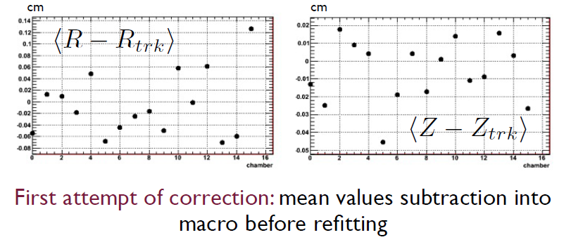
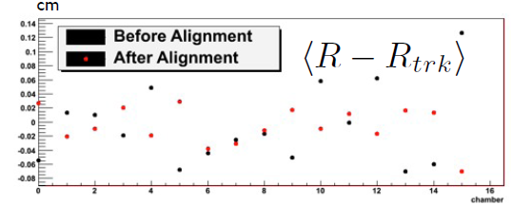
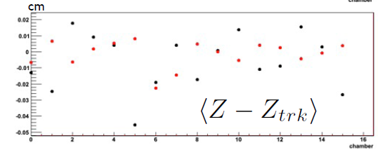
Preliminary analysis of cosmic ray data
Tracks fitted by 3-D straight lines. Computed R and Z distance of track
from nominal position of each chamber.
Mean R ∼ -440 micron
Mean Z ∼ -190 micron
Analysis in progress
Chamber
Chamber
IMPROVED,
Starting point
for new iteration.
Chamber
Chamber

Slide 24
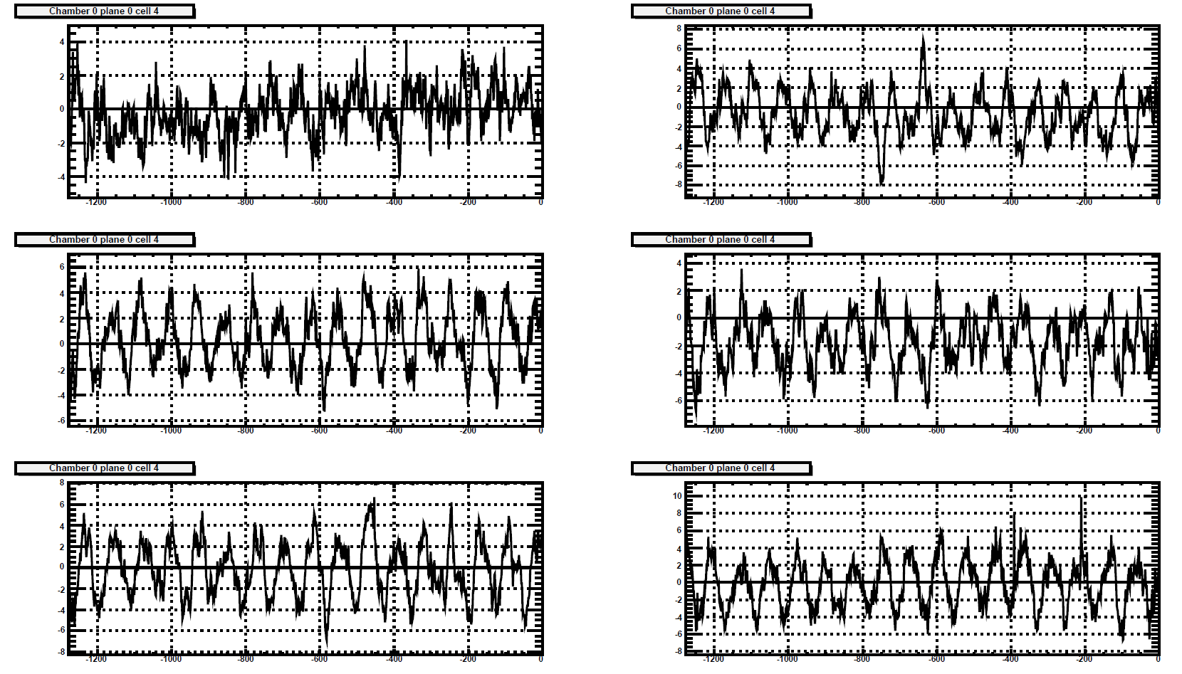
DCH: coherent noise
The remaining noise is more “white” then before
RMS reduced from 2.7 mV to 1.2 mV – more then twice
This is just an example, dominated frequency are visible in almost all WFs
Possible tool to improve Z resolution
Low frequency (≈ 13 MHz) noise; more visible on pads.
Can be fitted with a single or double sinusoidal shape and subtracted

Slide 25
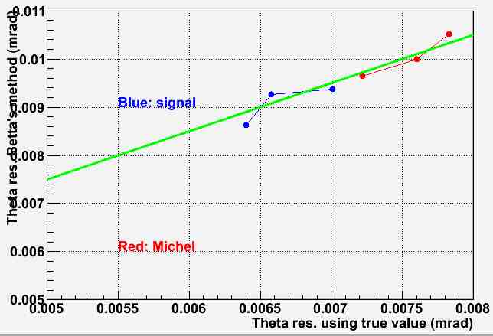
DCH: MC studies
Event Type | MC Z Sigma | Angular Resolution (θ)
Michel | 100 μm | 7.0 mrad
Michel | 300 μm | 7.2 mrad
Michel | 470 μm | 7.6 mrad
Michel | 470 μm (70%) + 1.5 mm (30 %) | 7.9 mrad
Signal | 100 μm | 6.0 mrad
Signal | 300 μm | 6.4 mrad
Signal | 470 μm | 6.6 mrad
Signal | 470 μm (70%) + 1.5 mm (30 %) | 7.0 mrad
Usual way of measuring the angular
resolution (double turn method) gives
a systematically worse result than the
difference wrt true value (2÷3 mrad shift).
Resolution for signal events is better than
for Michel events.
3
2
3
2
1
1
Angular resolution depends on Z
resolution, but not dramatically;
To obtain a 15 mrad angular
resolution one should use an
abnormally bad value σ_{Z} = 3 mm.
1: 300 micron, single gaussian
2: 470 micron, single gaussian
3: double gaussian

Slide 26
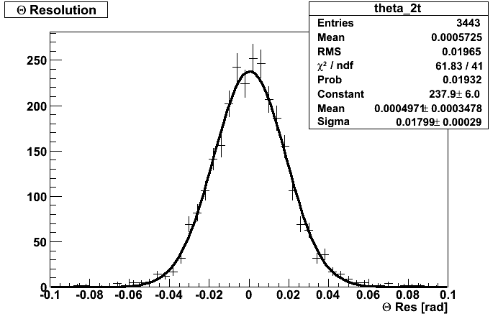
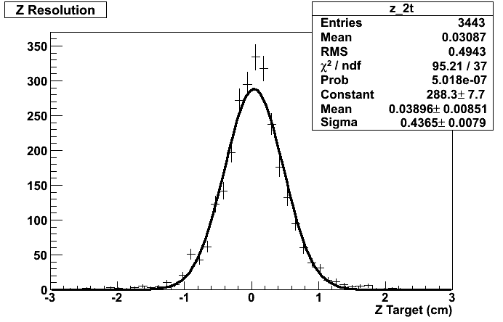
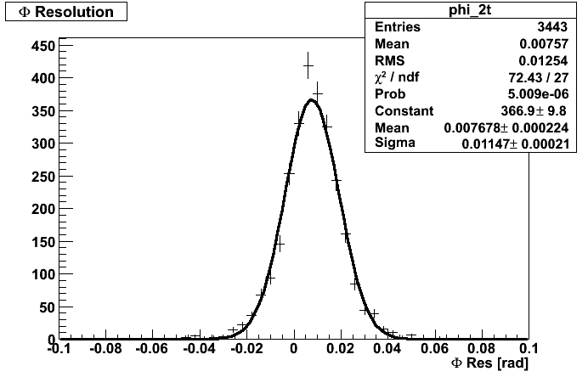
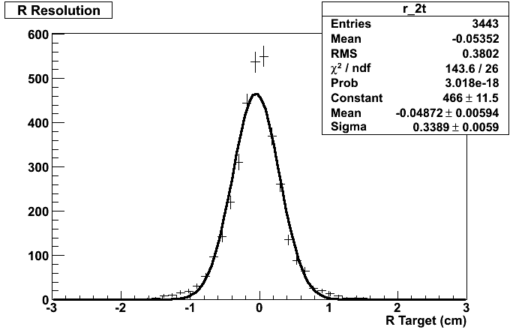
DCH: present situation
σ_{θ} = 12.7 mrad
σ_{Z} = 3.1 mm
≥ 8 hits, TC+DCH match as in 2008
50 MeV < E < 54 MeV
σ_{φ} = 8.1 mrad
σ_{R} = 2.4 mm

Slide 27
DCH: Comments
Comparison between MC and present level of analysis (all in mrad):
Data (2-turn) MC (2-turn) MC (true)
Michel θ 12.7 10.5 8
Signal θ not avail. 8.6 7
Michel φ 8.1 8.0 7 fulfilled !
Signal φ not avail. 7.1 6.5
Central column is our goal ! Not too far, but several possible actions …
Refine single hit Z calibrations;
Check the hit reconstruction/pattern recognition/tracking algorithms;
Check the database;
Refine comparisons with MC (number of hits, inefficiencies, materials …);
Improve CR data analysis ⇒ misalignment corrections, survey ….
Subtract coherent noise;
Understand and correct other effects which can deteriorate the resolution (cross
talks, chamber breathing …)

Slide 28
Timing Counter
Several calibrations:
- Time Walk with triple events ⇒
intrinsic bar resolution;
- z-offset;
- effective velocity (under way);
- timing calibration with MEG (Michel) and Dalitz
events ⇒ inter-bar and Teγ (Boron for check);
All constants in the database.

Slide 29
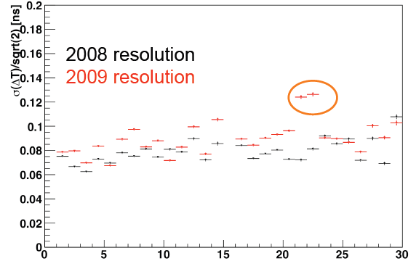
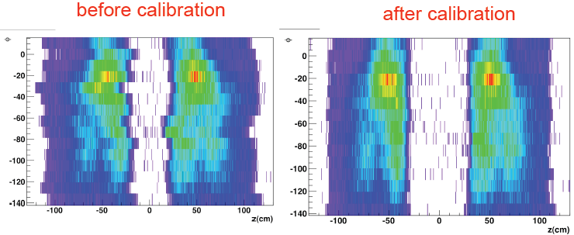
Timing Counter cnt.
Bar instrinsic resolution
Intrinsic resolution is a bit worse
than in 2008.
Studies under way to figure out the
origin of the discrepancies.
However, (70 ÷ 100) ps is still
acceptable.
MEG Data.
Z offset calibration
with Michel events

Slide 30
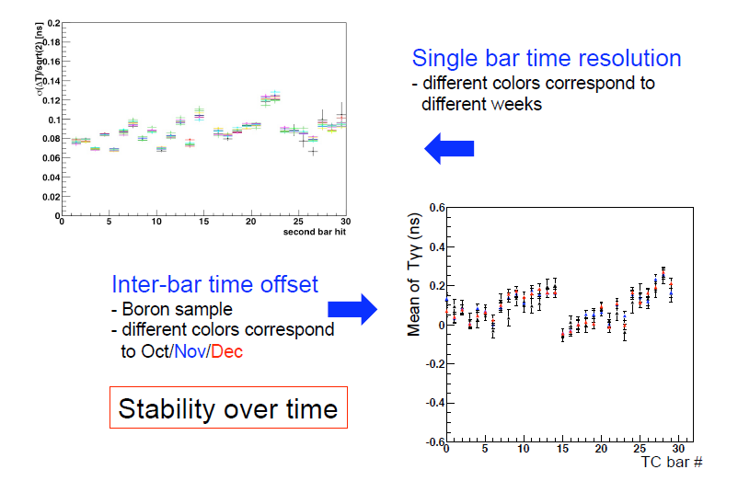
Timing Counter cnt.

Slide 31
Timing Counter: Comments
TC bars stable during 2009 data taking;
TC resolutions look a bit worse than in 2008;
We expect some improvements from the next re-
processing (better TC-DCH match; more accurate
determination of calibration constants …);
Some calibrations are under refinement (effective
light velocity, inter-bar timing …);
MC studies of Dalitz events to disentangle the
contribution of track length uncertainty;
….

Slide 32
Xenon Calorimeter
Calibration chain almost completed:
LED/Gain variation with time;
Q.E. determination by alpha data in liquid Xenon (in 2008: gaseous Xenon);
Uniformity corrections;
Pedestal determination (CEX-μ difference);
Timing constants for two different algorithms;
Full implementation in the database under completion;
Everything ready before the next re-processing (sometimes in March).
Checks:
Uniformity of CW line energy;
Linearity.
Results:
Energy resolution with π⁰;
Background spectrum.

Slide 33
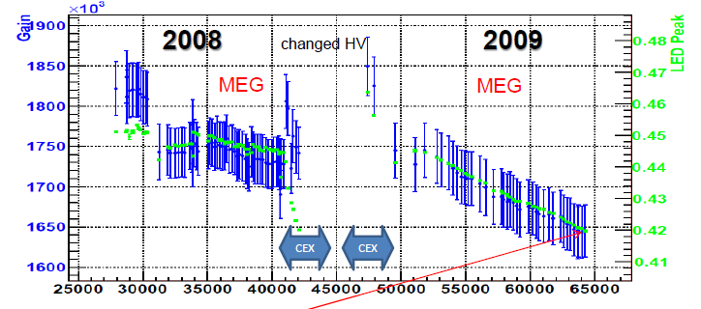
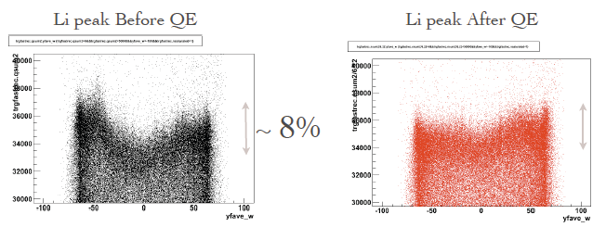
Xenon Calorimeter cnt.
Gain decrease correction
10% decrease
Effect of first QE set.
Further refinements
under way to precisely
match the calorimeter
optical properties:
reflections
Rayleigh scattering …
∼ 3.3 %

Slide 34
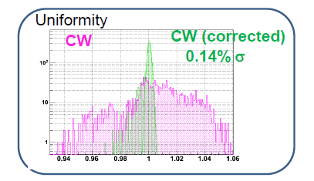
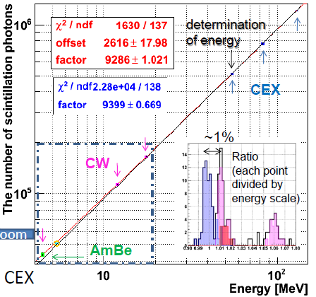
Xenon Calorimeter cnt.
Linearity curve determined by using π⁰.
CW points look displaced by 1% (under study).
Uniformity of 17.6 MeV CW Li
peak. Each point represents the
reconstructed position of the
Li peak in a 3-D spatial bin.

Slide 35
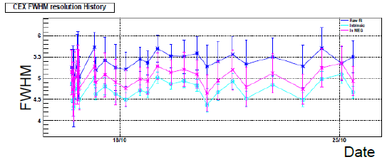
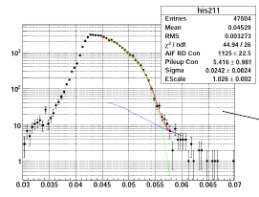
Xenon Calorimeter cnt.
CEX energy resolution (FWHM) as a
function of time. Purple line obtained
by inserting pedestal fluctuations
in MEG runs.
σ_{upper} = 2.0% in a 2x2 PMTs grid
(usual 1x1); 1.95% for collimator #8.
Background spectrum.
Fit with a combination of RD+AIF (Green),
and Pile-up (Blue).
- Resolution just a bit worse than in 2008;
- Energy scale not exactly 1 because of
a mistake in configuration parameters
(data to be reprocessed).

Slide 36
Xenon Calorimeter: Comments
Calibration chain used in 2008 looks adequate.
Work in progress for further improvements
(i.e. Q.E determination);
Energy resolution a bit worse than in 2008,
but analysis work still preliminary. Nevertheless,
5% FWHM goal in energy resolution already fulfilled.
Timing resolution requires further efforts:
- single PMT timing extraction;
- boards calibration/synchronization;
- ….
First background energy spectrum ⇒ preliminary PDF.

Slide 37
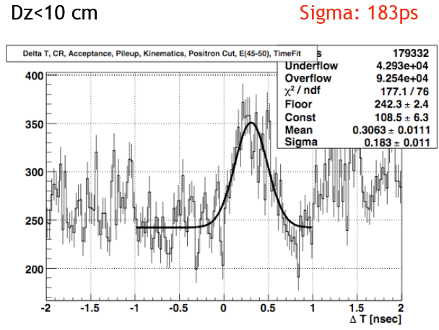
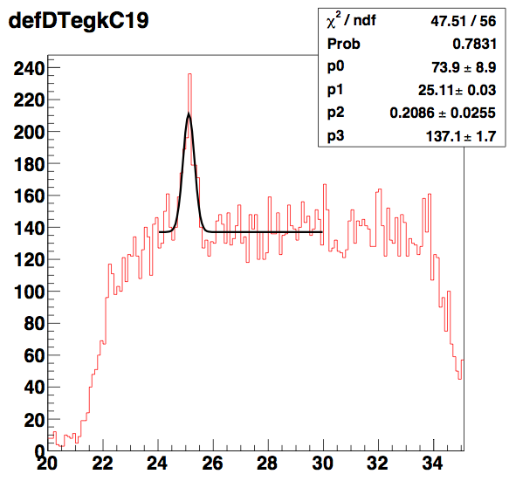
RMD observation 1)
Three independent analyses, with different cuts or no cuts at all.
Peak well visible above background without need of refined searches.
All bars
Single bar
σ = 209 ps
Offset subtracted, but mean displaced by ∼ 300 ps

Slide 38
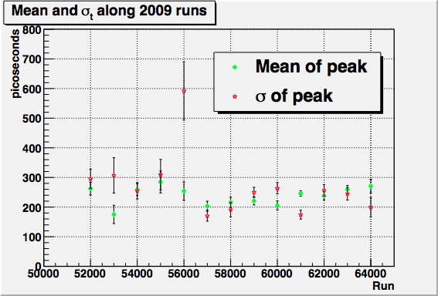
RMD observation 2)
RMD signal stable along
the data taking period.
In 2008 the signal became
less and less visible
because of the reduced
DCH efficiency.
Pre-selection window needs to be re-centered.
Resolution is some tens of ps worse than at the end of 2008
(XEC/TIC calibration constants ? tracking ? To be addressed)

Slide 39
Perspectives for 2009 data analysis

Slide 40
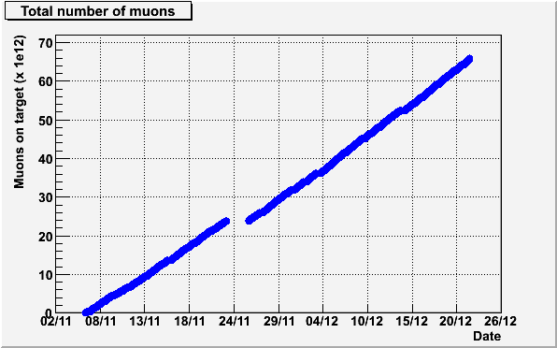
2009 Data Sample
Short run, but very smooth
Improved tracking and trigger efficiency
≈ 6.5 x 10¹³ muons stopped in the target
preliminary

Slide 41
Perspectives for 2009 data 1)
With respect to 2008 the starting conditions of our
analysis are generally better:
- Xenon calorimeter stable at predicted light yield;
- stable behaviour of DCH; only few channels not working properly;
- higher trigger efficiency ≈ 88% because of better direction
match LUT.
The analysis scheme we plan to use is similar to that of
2008, which allowed to produce our first paper:
- 2 ÷ 3 complete reprocessing, starting from waveforms
(< 2 weeks per each);
- some (∼ 5) reprocessing of pre-selected data (few days per each);
- pre-selection/selection/blinding windows to be refined.

Slide 42

Perspectives for 2009 data 2)
A strong calibration effort is under way on all sub-
detectors, based on the first data processing.
- Calibration constants still to be optimized;
- However, resolutions close to that obtained last year at the end of analysis chain;
- DCH angular resolutions already better than in 2008;
continuous optimization work by a dedicated working group;
- Possible improvements by alignment check;
- Xenon calorimeter energy resolution at 5% FWHM level;
- Improvements in timing resolution expected from DRS timing calibration;
Selections and cuts to be optimized to reach the best compromise
between resolutions/background rejection and efficiency.
Algorithms for final analysis (i.e. likelihood) well tested on 2008 data.
A detailed job list with time schedule
will be prepared as in 2008 !

Slide 43
Physics analysis schedule for 2009
ICHEP2010
(submission)
ICHEP2010
Feb
Mar
Apr
May
Jun
Jul
Finalize
Calibrations/resolutions
Next reprocessing(s)
Final reprocessing
Reprocessing
BG Estimation
Open box
Final analysis
Normalization
Systematics
Update
Various checks of final result

Slide 44
Performance Summary
measured in sigma
 | 2008 | 2009 (preliminary) | 2010 (preliminary) | “Goal”
Gamma Energy (%) Gamma Timing (psec) Gamma Position (mm) Gamma Efficiency (%) e⁺ Timing (psec) e⁺ Momentum (%) e⁺ Angle (mrad) e⁺ Efficiency (%) e⁺-gamma timing (psec) Muon Decay Point (mm) Trigger efficiency (%) | 2.0(w>2cm) 80 5(u,v)/6(w) 63 <125 1.6 10(φ)/18(θ) 14 148 3.2(R)/4.5(Z) 66 | ← >67 ← ← ← 0.85 8(φ)/11(θ) 40 <180 2.2(R)/3.1(Z) 88 | 1.5(w>2cm) 68 ← ← 90 0.7 8(φ)/8(θ) 40 120 1.4(R)/2.5(Z) 94 | 1.2 43 3.8(u,v)/5.9(w) 60 50 0.3-0.38(100%) 3.8-5.1 90 64 0.9-1.1 100
Stopping Muon Rate (sec⁻¹) DAQ time/Real time (days) | 3×10⁷ (300μm) 48/78 | 2.9×10⁷(300μm) 35/43 | 3×10⁷ (300μm) 133/162 | 3×10⁷ 300/-
S.E.S @90% box Expected NBG Sensitivity BR upper limit (obtained) | 5×10⁻¹² 0.5 1.3×10⁻¹¹ 2.8×10⁻¹¹ | 2.3×10⁻¹² 0.7 6.6×10⁻¹² - | 4.0×10⁻¹³ 0.9 1.3×10⁻¹² - | 3.8×10⁻¹⁴ 0.5 1.0×10⁻¹³ -

Slide 45
2009 Expected Sensitivity
Estimate by means of toy MC simulation/Feldman-Cousins.
  Updated resolutions and data statistics in table
  NBG in analysis window estimated by scaling NBG in analysis window in 2008
  A little narrower analysis window (signal efficiency x 0.95)
  NBG expected in analysis window: 435
NBG in (old) 90% signal box: 1.1
Results:
  Average Nsignal upper limit: 6.9
  Average BR upper limit: 6.6×10⁻¹²
    6.9 × (2.0 × 10⁻¹²)/2.2/0.95
2008 sensitivity in
analysis window
Improvement in data
statistics wrt 2008

Slide 46
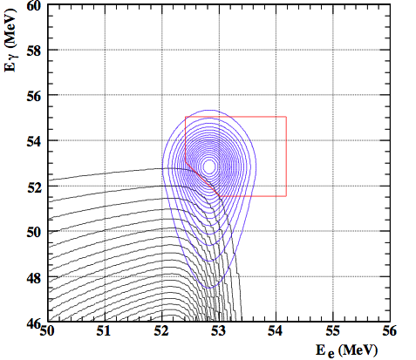
Expected Sensitivity for 2010 or later
Estimate by means of Poisson statistics/Feldman-Cousins
  Updated resolutions and data statistics in table
  NBG in signal box is estimated by the PDF probability ratio.
  Asymmetric 90%-efficiency signal box to optimize S/N
  (same efficiency but less BG)
Results
  2010 (stat. ratio to 2008: 11.4)
    S.E.S.: 4.0 × 10⁻¹³
    NBG: 0.9
    UL: (4.0 × 10⁻¹³ ) × 3.2 = 1.3 × 10⁻¹²
  2010 + 2011 + 2012 (stat. ratio to 2008: 11.4 + 13.4 + 13.4)
    S.E.S.: 1.2 × 10⁻¹³
    NBG: 3.0
    UL: (1.2 × 10⁻¹³ ) × 4.41 = 5.3 × 10⁻¹³

Slide 47
Backup slides

Slide 48
Analysis cuts
Positron
Track quality cuts (minimum number of hits and chambers, good chi2 for fit …);
Selection of track with best pattern recognition;
Track timing determined by position matching between DCH and TC;
Elliptical cuts on target and beam spot at COBRA centre.
(Already used to evaluate normalization factor by means of Michel positron events)
Cosmic ray rejection based on front/back charge ratio on the LXe calorimeter;
Fiducial volume cut for photons;
Pile-up identification in the LXe calorimeter and photon energy correction;
Collinearity cut on photon-positron relative angle;
50 MeV < E_{e} < 56 MeV;
46 MeV < E_{γ} < 60 MeV;
|Δt_{eγ}| < 1 ns;
Multiple algorithms and two independent digitizers for photon energy/timing ⇒ checks !
Photon and photon-positron correlation

Slide 49
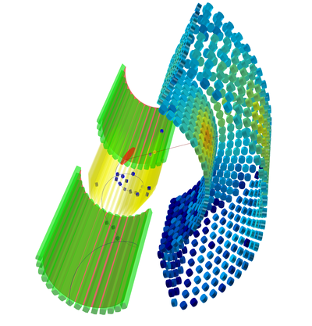
3-D view of a MEG event
Photon Trajectory
Positron Track
Hits in XEC
Hits on DCH
Hits on TC

Slide 50
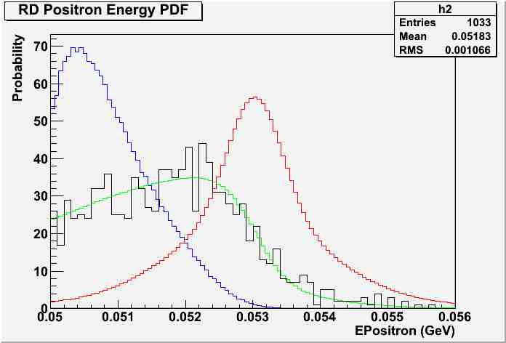
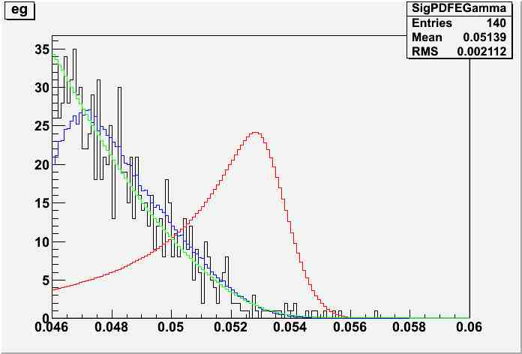
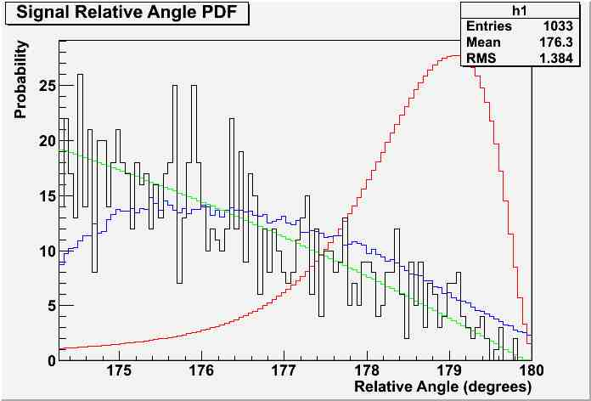
Events in signal region vs pdf’s
Positron Energy
Gamma Energy
Gamma Positron Angle
Distributions normalized to the total number of events Black: real events
Red: signal pdf
Blue: RD pdf
Green: accidental pdf

Slide 51
Systematic Effects 1)
N_{Sig}
(90 % C.L.)
E_{γ}
σ(E_{γ})
Analysis repeated
by changing one
parameter at a
time and building
new pdfs.
0.6 % error
on E_{γ} scale ⇒
ΔN_{Sig}= 0.6
%
%
N_{Sig}
(90 % C.L.)
σ(Δt)
Δt
psec
psec

Slide 52
Systematic Effects 2)
σ_{φ}, σ_{θ} = (10 mrad, 18 mrad) x X
Positron angular resolution
Assuming 10% error ⇒ ΔN_{Sig} = 0.35
Positron Energy Scale
300 keV error ⇒ ΔN_{Sig} ≈ 1

Slide 53
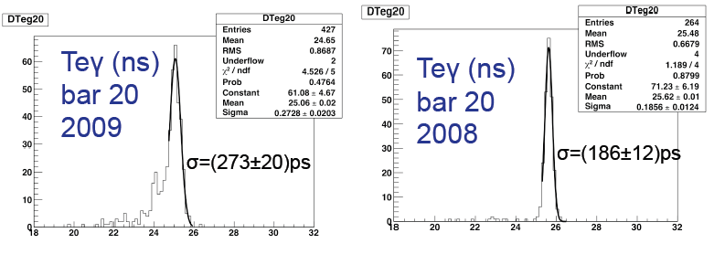
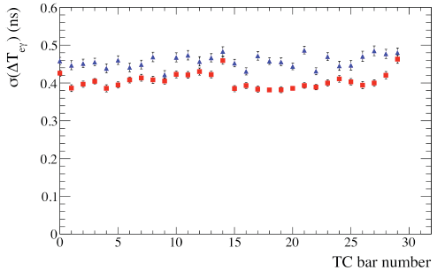
Timing Counter cnt.
T_{eγ} distribution
obtained with
Dalitz sample.
ΔT (ns)
ΔT (ns)
Check with Boron sample
Blue: 2009
Red: 2008 (final reprocessing)

Slide 54
Xenon Calorimeter cnt.
Timing resolution
Intrinsic timing resolution is good (∼ 45 ps);
Electronic + analysis contribution to LXe-TC
timing resolution measured by using a split pulse.
Sigma ≈ (105 ÷ 120) ps, dominated by
inter-board synchronization.
Lower contributions from smoothing
functions (different for DRS2 and DRS4) and
same board synchronization.

Slide 55
Comments
Gamma energy 1.5% (2010): resolution measured at the best position in 2009
Gamma timing 68 ps (2010): resolution measured at CEX in Dec.2008. Better
than resolution quoted for run2008 (80ps) due to light yield improvement.
Positron timing <125 ps (2008/2009): 148(e-γ)⊖80(Xe), including DRS effect partially.
Positron timing 90 ps (2010): 70(TC) ⊕ 60ps (path length, MC)
Positron-Gamma timing 120 ps (2010): 70ps (TC) ⊕ 60ps (path length, MC) ⊕ 68ps (Xe).
No contribution from DRS.
Positron momentum 1.6% (2008): average over core and 2 tails
Positron momentum 0.85% (2009): single Gaussian
Positron momentum 0.7% (2010): single Gaussian
Positron angle 8 mrad(φ), 11 mrad(θ) (2009): resolution measured in MC by two-turns
track method
Positron angle 8mrad(φ), 8mrad(θ) (2010): resolution measured in MC
Positron efficiency 40% (2009/2010): measured in 2009 with trg22
Muon decay point 2.2mm(R), 3.1mm(Z) (2009): resolution measured by two-turns track
method
Muon decay point 1.4mm(R), 2.5mm(Z) (2010): resolution measured in MC by two-turns
track method
DAQ time: (real) days for the MEG trigger DAQ time (Peter’s estimation)
NBG in 90% signal box (2008/2009): recalculated with NEW asymmetric signal box.

